Slide 1


Session 2: Stacks, Queues
and De-queues.

Slide 2

Agenda
Vectors and Big O - Recap
Stacks
Queues
Practice Problem
De-queues
Practice Problem Vol.2

Slide 3
Powerful resources
GeeksforGeeks Data structures section: https://www.geeksforgeeks.org/data-structures/?ref=shm
Visualization tool for Data structures: https://www.cs.usfca.edu/~galles/visualization/Algorithms.html
CS50 Data Structures: https://www.youtube.com/watch?v=2T-A_GFuoTo&t=80s
Time Complexity Cheat Sheet: https://www.bigocheatsheet.com/
Stacks and queues, Buffalo University https://cse.buffalo.edu/~shapiro/Courses/CSE116/notes10.html

Slide 4

Vectors
A vector, list, or ArrayList is a dynamic allocated abstracted array.

Slide 5

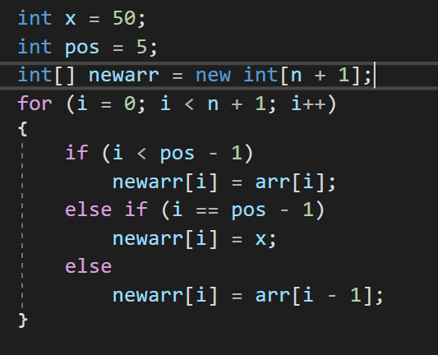
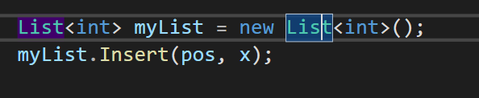
Why?
Insert an element inside an array

Slide 6
Big O
Let’s end the confusion
It’s not a programming notation. It’s simply a mathematical notation that describes the limiting behavior of a function
Simply, it’s a way to tell your programming mates how well your code is in terms of time and space. (Efficiency)

Slide 7
Big O Cont’d
for (int i = 0; i < N; i++) --->> 3N times
{
sum+=arr[i] --->> 2N times
}
for (intfor (int i = 0; i < N; i++) --->> {
sum+=arr[i]
for (int i = 0; i < N; i++) --->> {
sum+=arr[i]
for (int i = 0; i < N; i++) --->> {
sum+=arr[i]
for (int i = 0; i < N; i++) --->> {
sum+=arr[i]
i = 0; i < N; i++) --->> {
sum+=arr[i]
}
I won’t calculate all the lines.

Slide 8
And here comes Big O
A basic step that is independent of how the input is or a constant O(1).
Other than that? We measure in terms of the fastest growing term, And we take out the coefficient.
Why do we take out the coefficient?

Slide 9
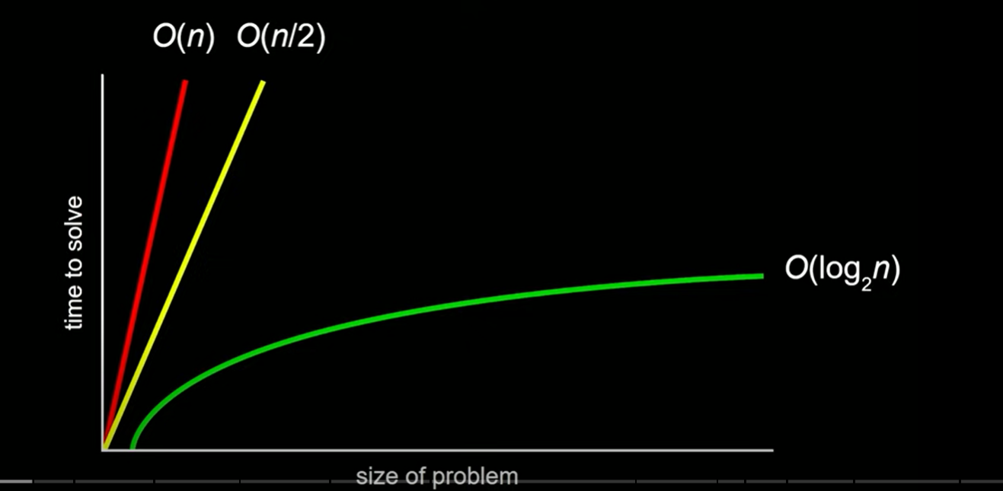
Big O notation

Slide 10
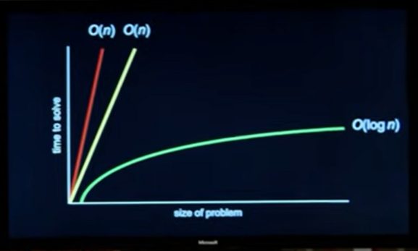
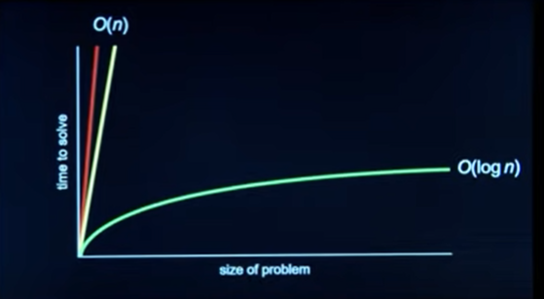
Big O notation
More on freecodecamp
https://www.freecodecamp.org/news/big-o-notation-why-it-matters-and-why-it-doesnt-1674cfa8a23c/

Slide 11
Stacks
Restriction? Why?
What is it?
A stack is a data structure that defines the logic of LIFO. Last in First Out
When we add or remove components of linear data structures, they grow and shrink. If we restrict the growth of a linear data structure so that new components can only be added or removed only at one end, we basically have a stack.

Slide 12
Why?
Chats list? Most recent chat must be showen at the top, as well as emails list and SMS list.
Memory cache? can be used to retrieve recently used object.
The call stack. In a nutshell.
Learn more: https://techterms.com/definition/stack
Call stack – cs50 : https://www.youtube.com/watch?v=aCPkszeKRa4

Slide 13
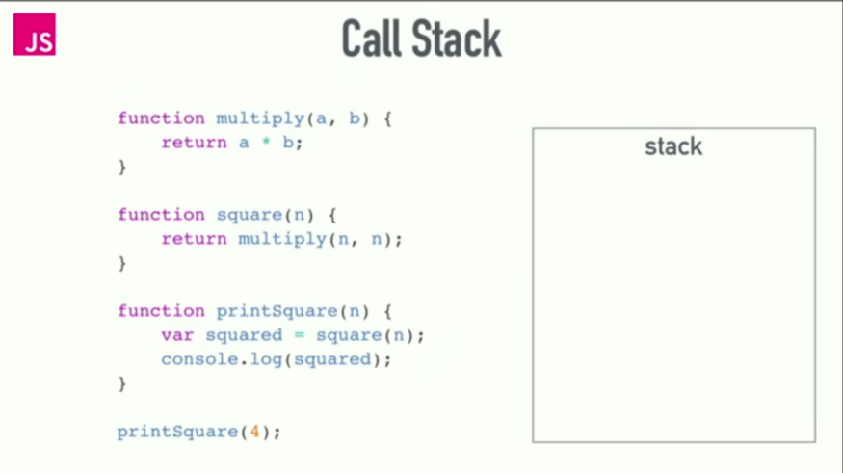
Call stack
Learn more: https://techterms.com/definition/stack
Call stack – cs50 : https://www.youtube.com/watch?v=aCPkszeKRa4

Slide 14
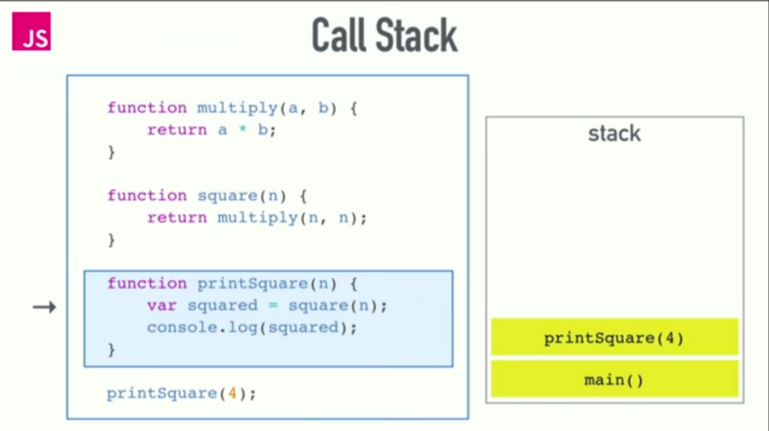
Call stack
Learn more: https://techterms.com/definition/stack
Call stack – cs50 : https://www.youtube.com/watch?v=aCPkszeKRa4

Slide 15
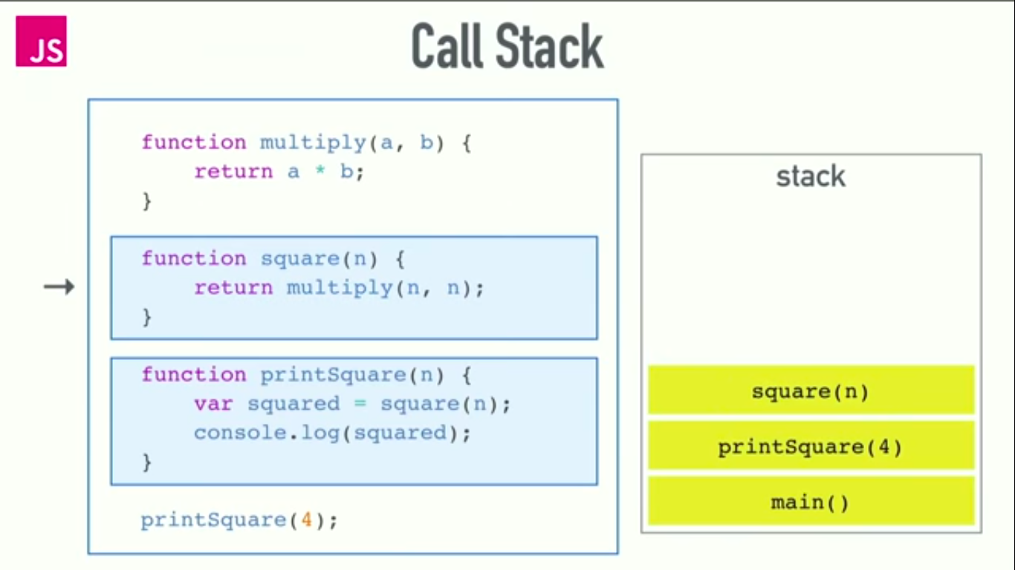
Call stack
Learn more: https://techterms.com/definition/stack
Call stack – cs50 : https://www.youtube.com/watch?v=aCPkszeKRa4

Slide 16
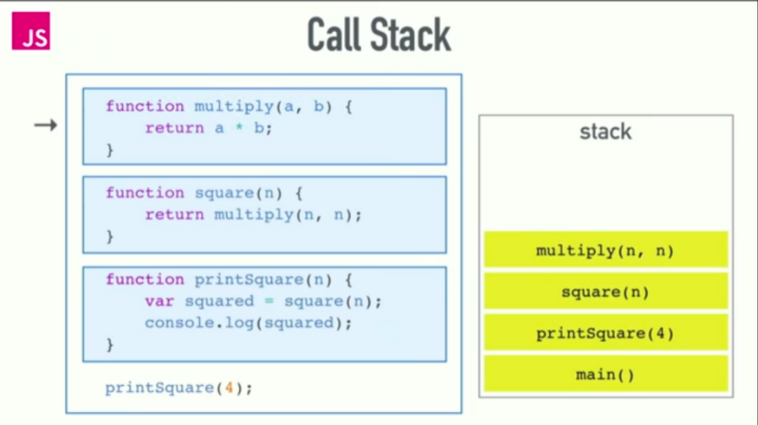
Call stack
Learn more: https://techterms.com/definition/stack
Call stack – cs50 : https://www.youtube.com/watch?v=aCPkszeKRa4

Slide 17
Call stack
Learn more: https://techterms.com/definition/stack
Call stack – cs50 : https://www.youtube.com/watch?v=aCPkszeKRa4

Slide 18
Call stack
Learn more: https://techterms.com/definition/stack
Call stack – cs50 : https://www.youtube.com/watch?v=aCPkszeKRa4

Slide 19
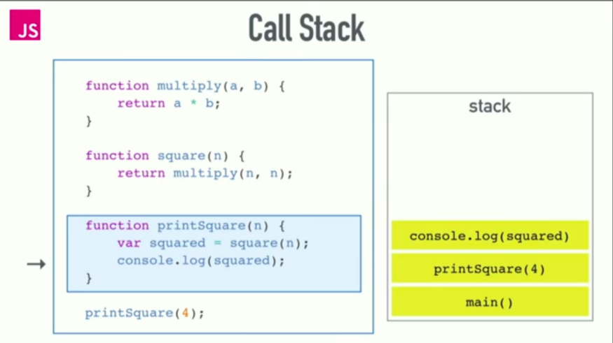
Call stack
Learn more: https://techterms.com/definition/stack
Call stack – cs50 : https://www.youtube.com/watch?v=aCPkszeKRa4

Slide 20
Call stack
Learn more: https://techterms.com/definition/stack
Call stack – cs50 : https://www.youtube.com/watch?v=aCPkszeKRa4

Slide 21
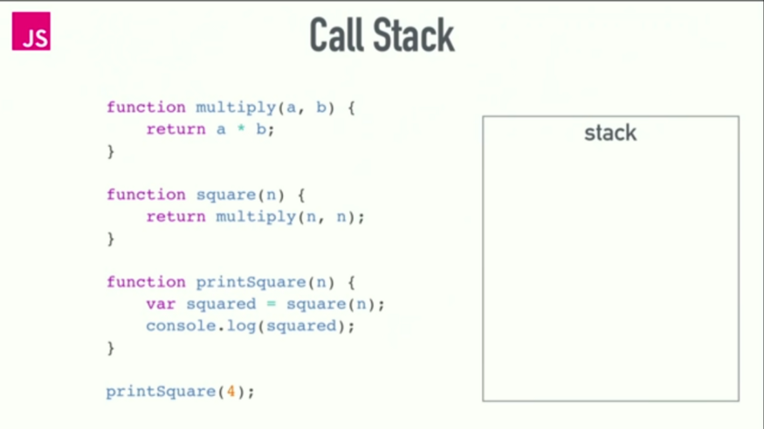
Call stack
Learn more: https://techterms.com/definition/stack
Call stack – cs50 : https://www.youtube.com/watch?v=aCPkszeKRa4

Slide 22
Stack operations.
empty() – Returns whether the stack is empty
size() – Returns the size of the stack – Time Complexity
top() – Returns a reference to the top most element of the stack
push(x) – Adds the element ‘x’ at the top of the stack
pop() – Deletes the top most element of the stack
Time complexity?
Learn more: https://techterms.com/definition/stack
Call stack – cs50 : https://www.youtube.com/watch?v=aCPkszeKRa4

Slide 23
5 Minutes Break
Learn more: https://techterms.com/definition/stack
Call stack – cs50 : https://www.youtube.com/watch?v=aCPkszeKRa4

Slide 24
Let’s practice
The IDE validator
You’re a programmer, you are writing some code and the ide yells at you that there’s no matching parentheses for your line.
Help the IDE validating parentheses.
Given a string s containing just the characters '(', ')', '{', '}', '[' and ']',
An input string is valid if:
Open brackets must be closed by the same type of brackets.
Open brackets must be closed in the correct order.
Learn more: https://techterms.com/definition/stack
Call stack – cs50 : https://www.youtube.com/watch?v=aCPkszeKRa4

Slide 25
Let’s practice
The IDE validator
Solution
Learn more: https://techterms.com/definition/stack
Call stack – cs50 : https://www.youtube.com/watch?v=aCPkszeKRa4

Slide 26
Queues
What is it?
A queue is a data structure that defines the logic of FIFO. First in First Out
When we add or remove components of linear data structures, they grow and shrink. If we restrict the growth of a linear data structure so that new components can only be added in the front and removed from the end we have a queue.

Slide 27
Why?
Restaurant orders? Must be added so it serves those who came first.
Network requests? To avoid bottlenecks.
Printers? So it can print papers in order.
Learn more: https://techterms.com/definition/queue

Slide 28
Queue operations.
empty() – Returns whether the queue is empty.
size() – Returns the size of the queue.
queue::front() and queue::back() in C++ STL – front() function returns a reference to the first element of the queue. back() function returns a reference to the last element of the queue.
Enqueue (X)
Dequeue()
Time complexity?
Learn more: https://www.geeksforgeeks.org/deque-cpp-stl/

Slide 29
Queue VS Stack.
Learn more: https://www.geeksforgeeks.org/deque-cpp-stl/

Slide 30
Queue Variation - Deque
Double ended queues are sequence containers with the feature of expansion and contraction on both the ends.
They are similar to vectors, but are more efficient in case of insertion and deletion of elements. Unlike vectors, contiguous storage allocation may not be guaranteed.
Random access guaranteed.
Learn more: https://techterms.com/definition/queue

Slide 31
Deque operations.
empty() – Returns whether the queue is empty.
size() – Returns the size of the queue.
queue::front() and queue::back() in C++ STL – front() function returns a reference to the first element of the queue. back() function returns a reference to the last element of the queue.
push_front(x), pop_front(x)
push_back(x), pop_back(x)
Time complexity?
Learn more: https://www.geeksforgeeks.org/deque-cpp-stl/

Slide 32
Why?
A web browser's history. Recently visited URLs are added to the front of the deque, and the URL at the back of the deque is removed after some specified number of insertions at the front.
Sorting a software application's list of undo operations.
Learn more: https://techterms.com/definition/queue

Slide 33
Let’s practice
Call Center Scheduling
You are on a software that manages a call center calls by receiving calls from customers and schedule it in order so whoever called first is served first.
Given an N number of calls, each call is represented by an integer that indicates its length in seconds, And a number K that represents the exact index when the receiving line was closed. Return the number of calls the call center can hold at once.
Example:
N = 5
[10, 20, 30, 10, 5]
K = 3
Output:
3, [10, 20, 30]

Slide 34
The End!
Don’t forget… the feedback form.
Solving is the way to take it all.
Thank you!

